Slide 1


CAPM
Explorer

Slide 2

Team Members
01
02
T L Anusha
Bhavana H
03
Punitha Rani

Slide 3


INTRODUCTION
The stock market is a complex and dynamic system that presents both opportunities and risks for investors.
In this presentation, we present an analysis of stock market data using Python programming language.
The analysis includes calculating daily returns, beta, and expected returns based on the Capital Asset Pricing Model (CAPM) for various stocks and portfolios

Slide 4

DATA
The data used in this analysis is a CSV file containing daily price data for various stocks such as Amazon, Google, and S&P500.
The data was obtained from a reliable source and wascleaned and preprocessed before analysis.

Slide 5

Methodology
Import Datasets and Visualize Stocks Data
Calculate Daily Returns
Calculate Beta for a Single Stock
Apply the CAPM Formula to an Individual Stock
Calculate Beta for All Stocks:
Calculate Beta for All Stocks
Calculate Expected Returns for All Stocks
Calculate Portfolio Returns

Slide 6

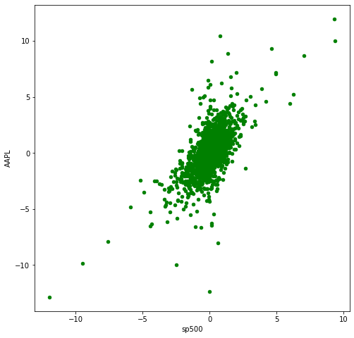
Result
Figure 1: Apple vs S&P 500 Scatter Plot

Slide 7
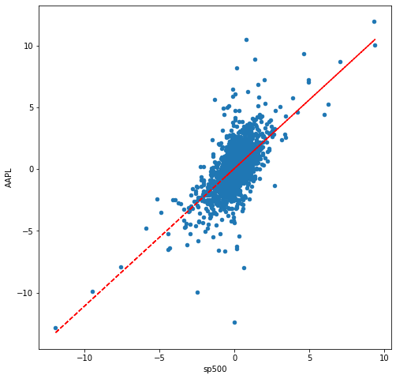
Result
Figure 2: Tesla vs S&P 500 Scatter Plot

Slide 8


Discussion
The analysis presented in this report provides valuable
insights into the expected returns on various stocks and
portfolios.
It is important to note that the analysis is based on historical data and does not guarantee future results
Therefore, investors should perform their own due diligence before making investment decisions
Beta and expected returns are just two of many factors that investors should consider when analyzing stocks

Slide 9

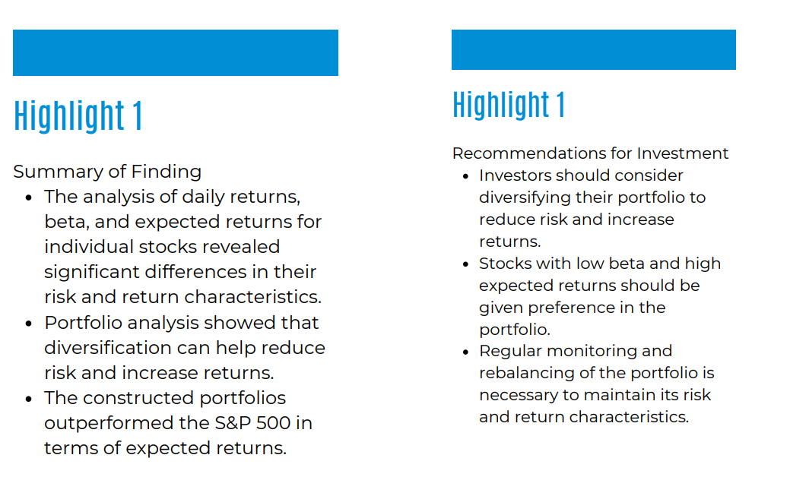
Conclusion

Slide 10


